Slide 1

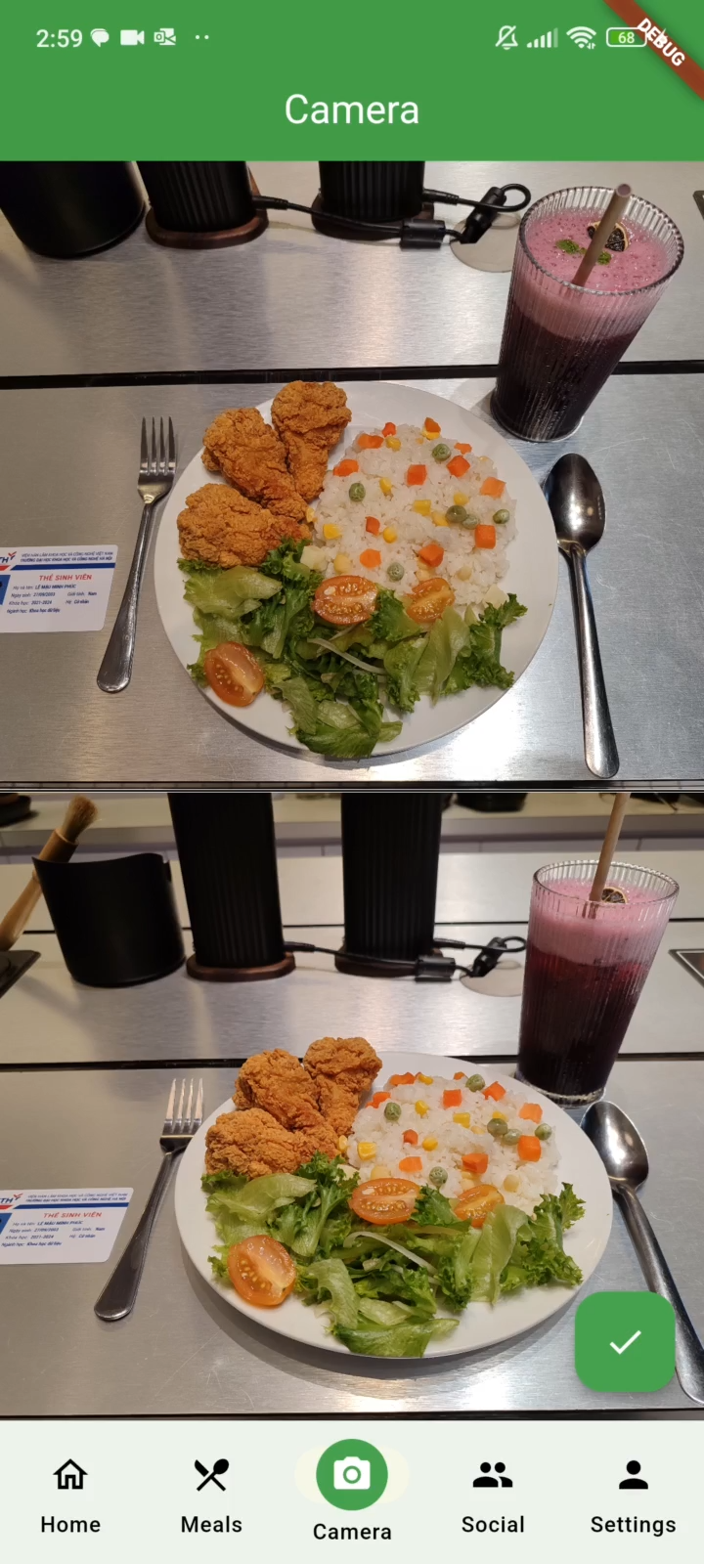
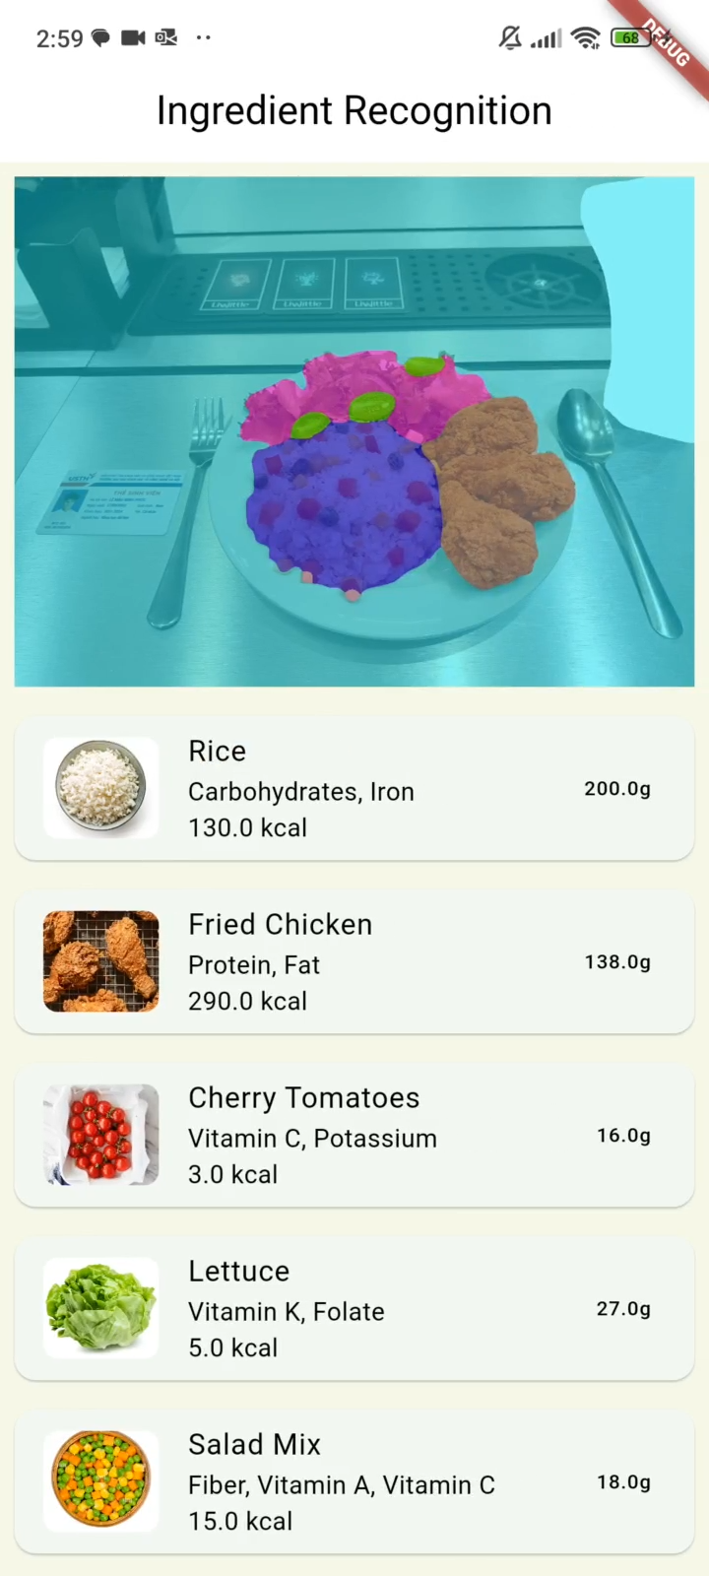

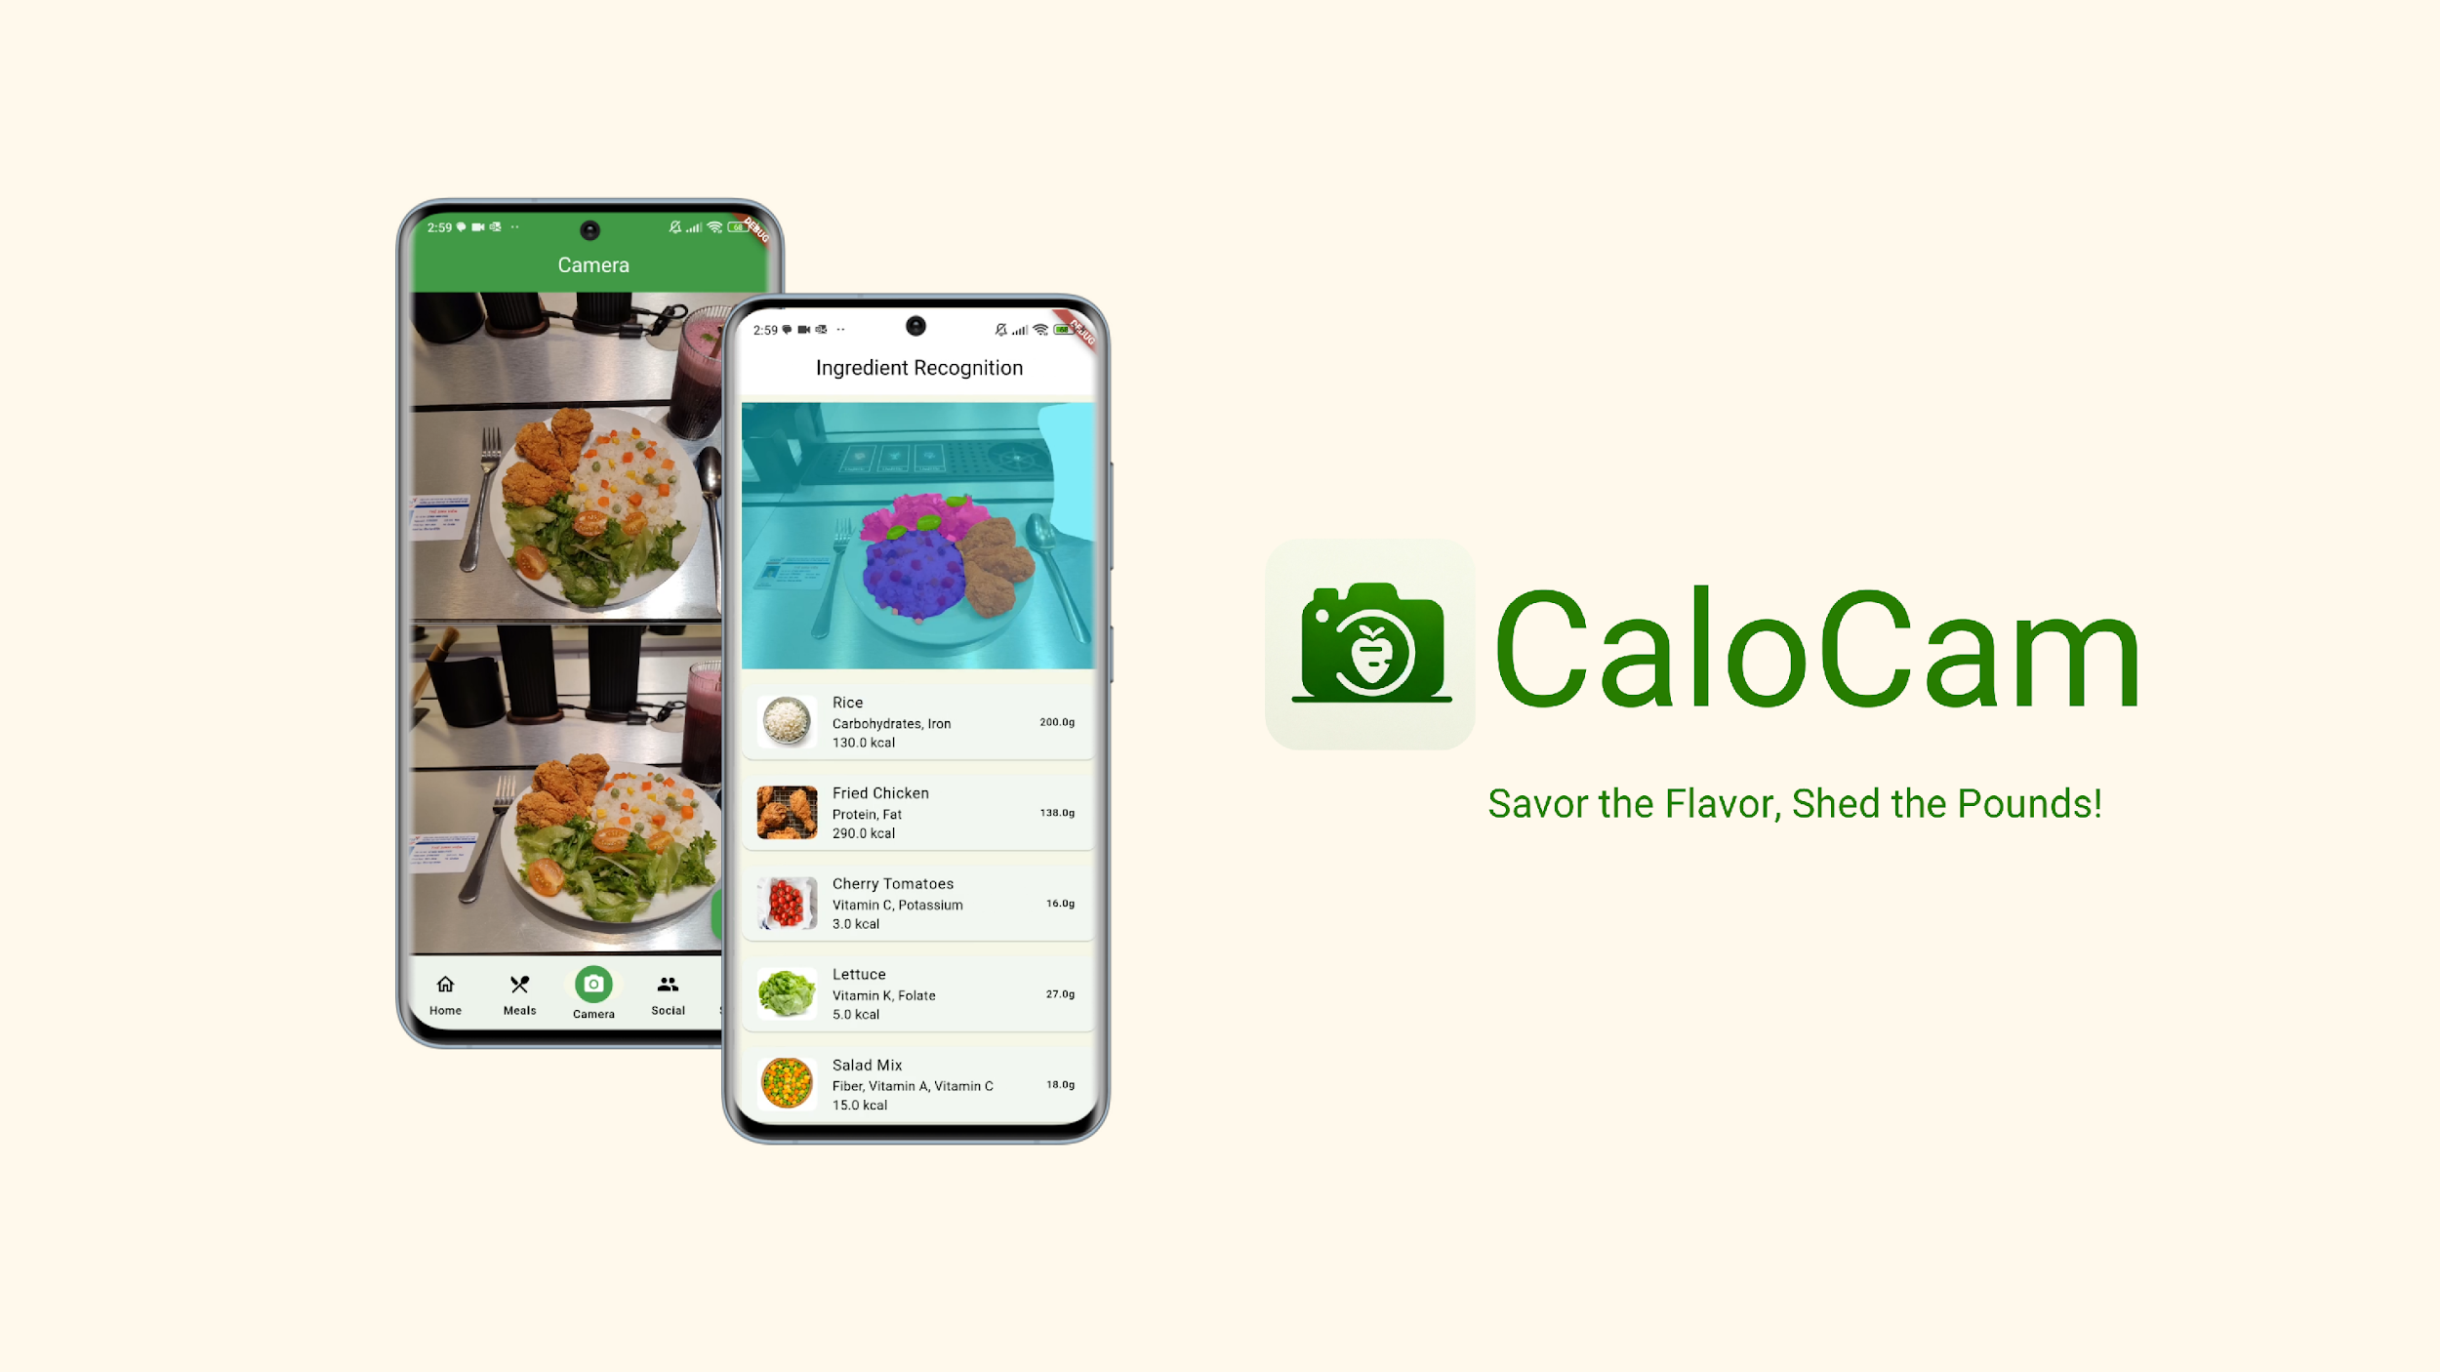
FOOD INGREDIENTS SEGMENTATION BASED ON DEEP LEARNING
Presented by Group 27

Slide 2

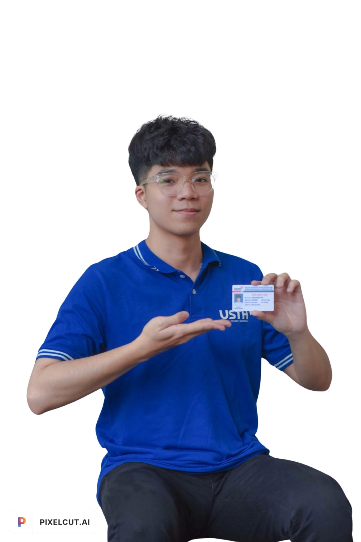
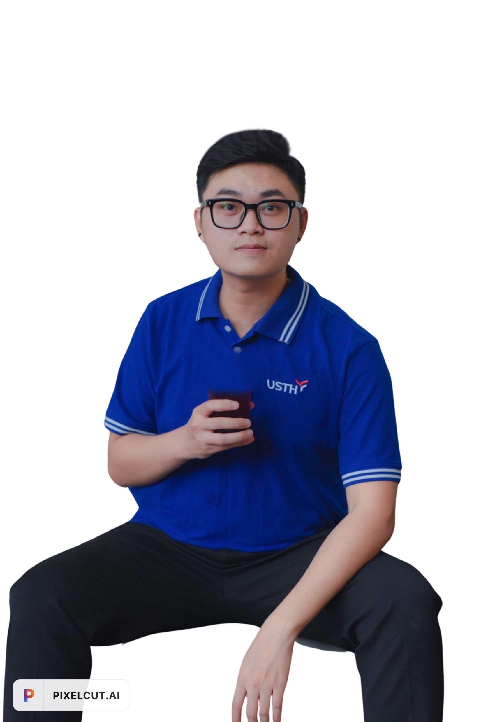
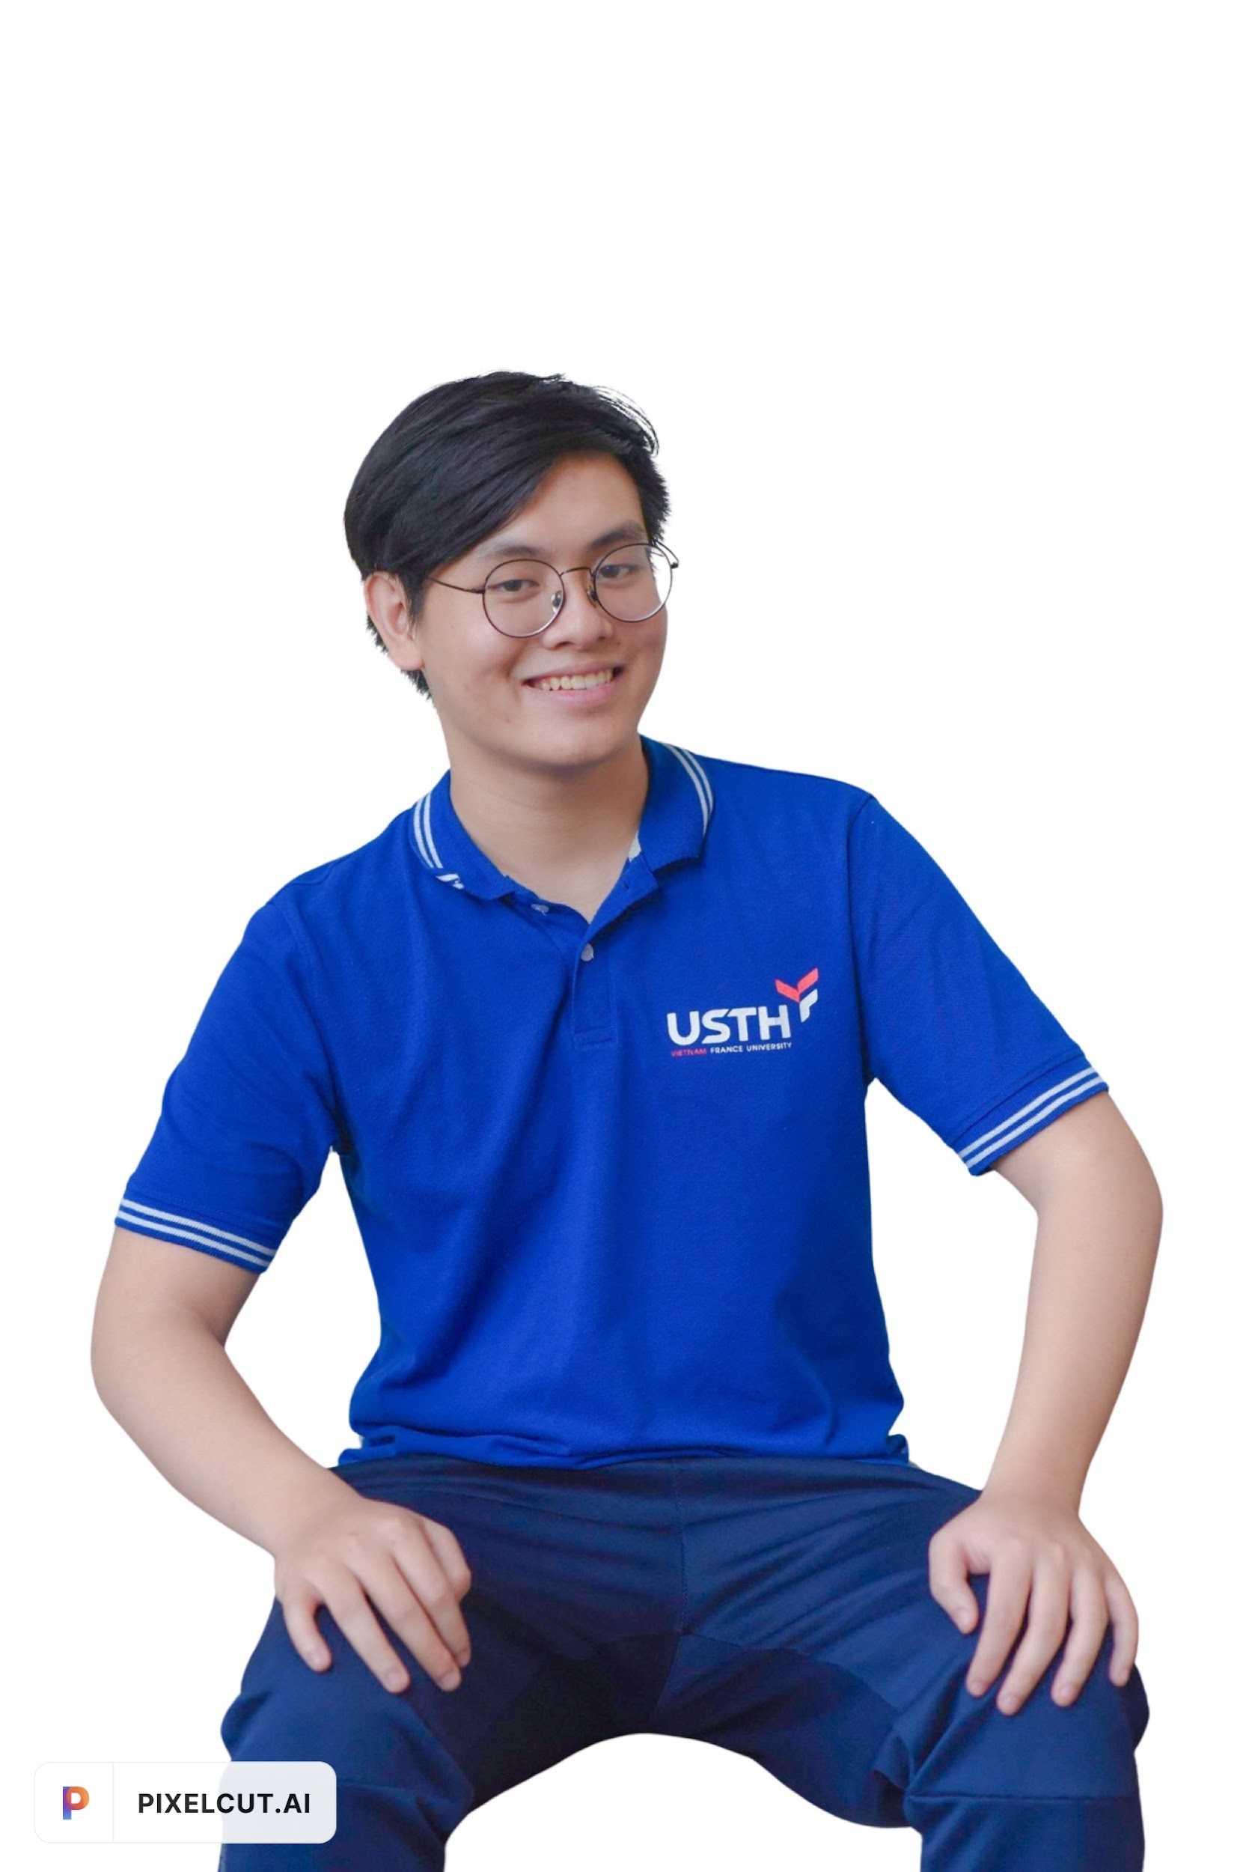
OUR TEAM STRUCTURE
Le Mau Minh Phuc
Pham Hai Nam
Nguyen Son
BI12-351
BI12-307
BI12-389

Slide 3
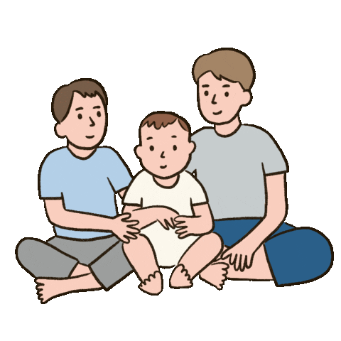
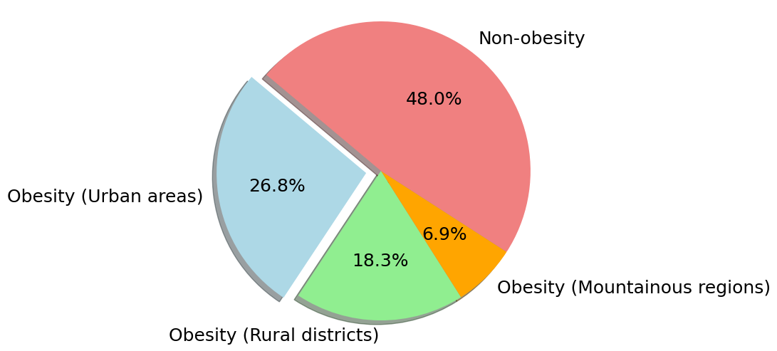

INSPIRATION FOR PROJECT STUDY
THE PROPORTION OF OBESE CHILDREN IN VIETNAM IN 2021
5 - 19 years old

Slide 4



INSPIRATION FOR PROJECT STUDY
Abdominal obesity
10 Males
10 Females
Obesity
Overweight
22 - 79 years old
Notes:
10 males – 6 males AO – 4 males Overweight – 1 obesity
10 females – 2 female (AO + Overweight)

Slide 5
INSPIRATION FOR PROJECT STUDY
Abdominal obesity
10 Males
10 Females
Obesity
Overweight
Overweight
22 - 79 years old
Abdominal obesity
Notes:
10 males – 6 males AO – 4 males Overweight – 1 obesity
10 females – 2 female (AO + Overweight)

Slide 6

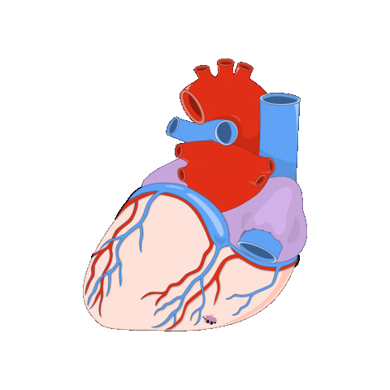


REPERCUSSIONS
Heart diseases
Fatty liver
Stroke
Certain cancers

Slide 7

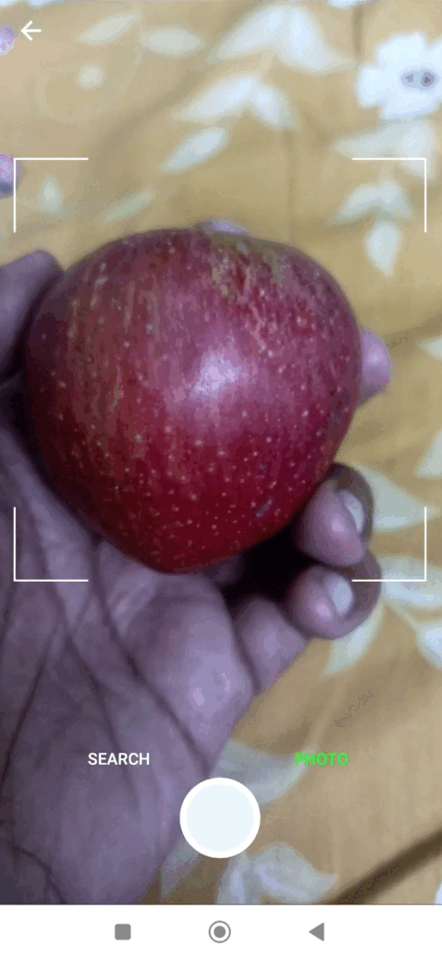


COMPETITORS / MARKET REFERENCES
Capture images
Volume estimation
Calories counting

Slide 8
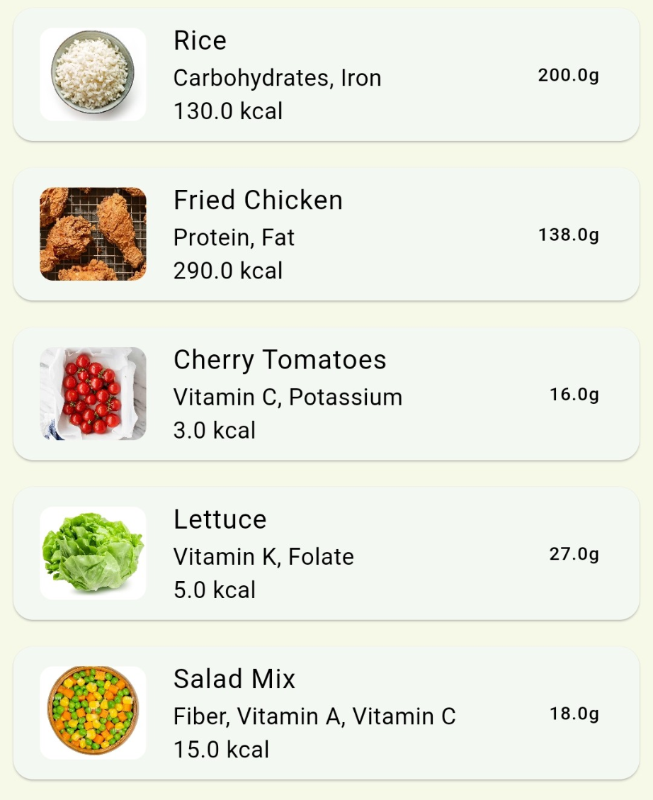
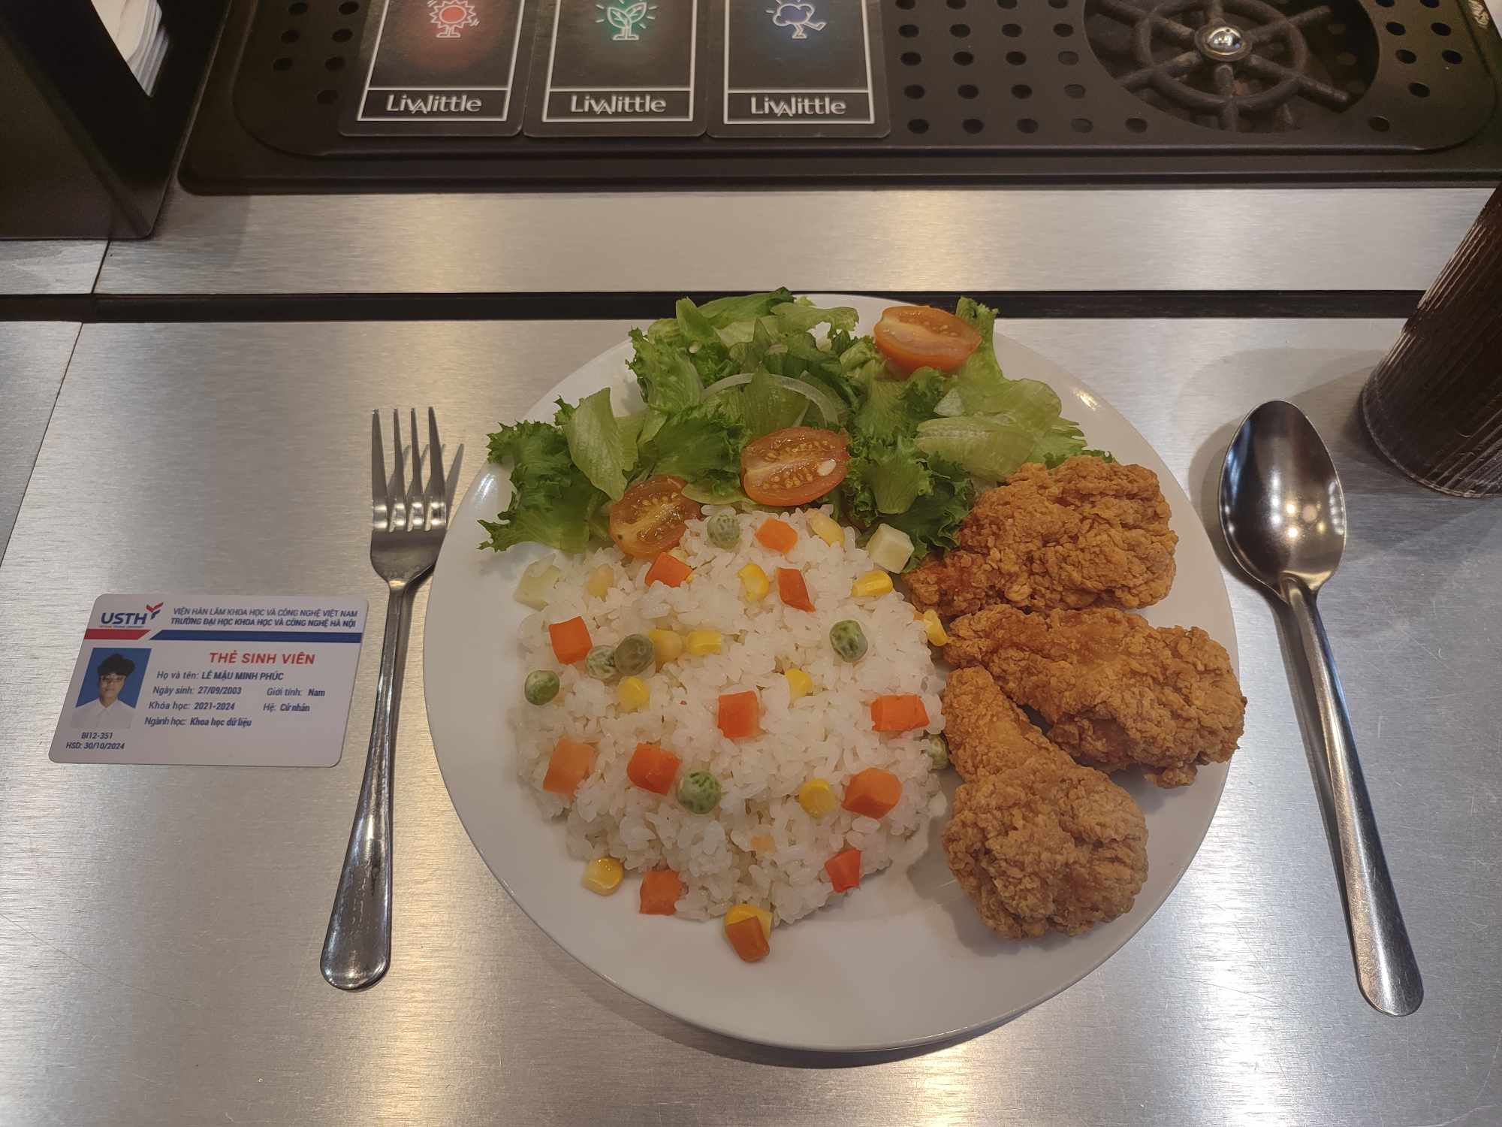
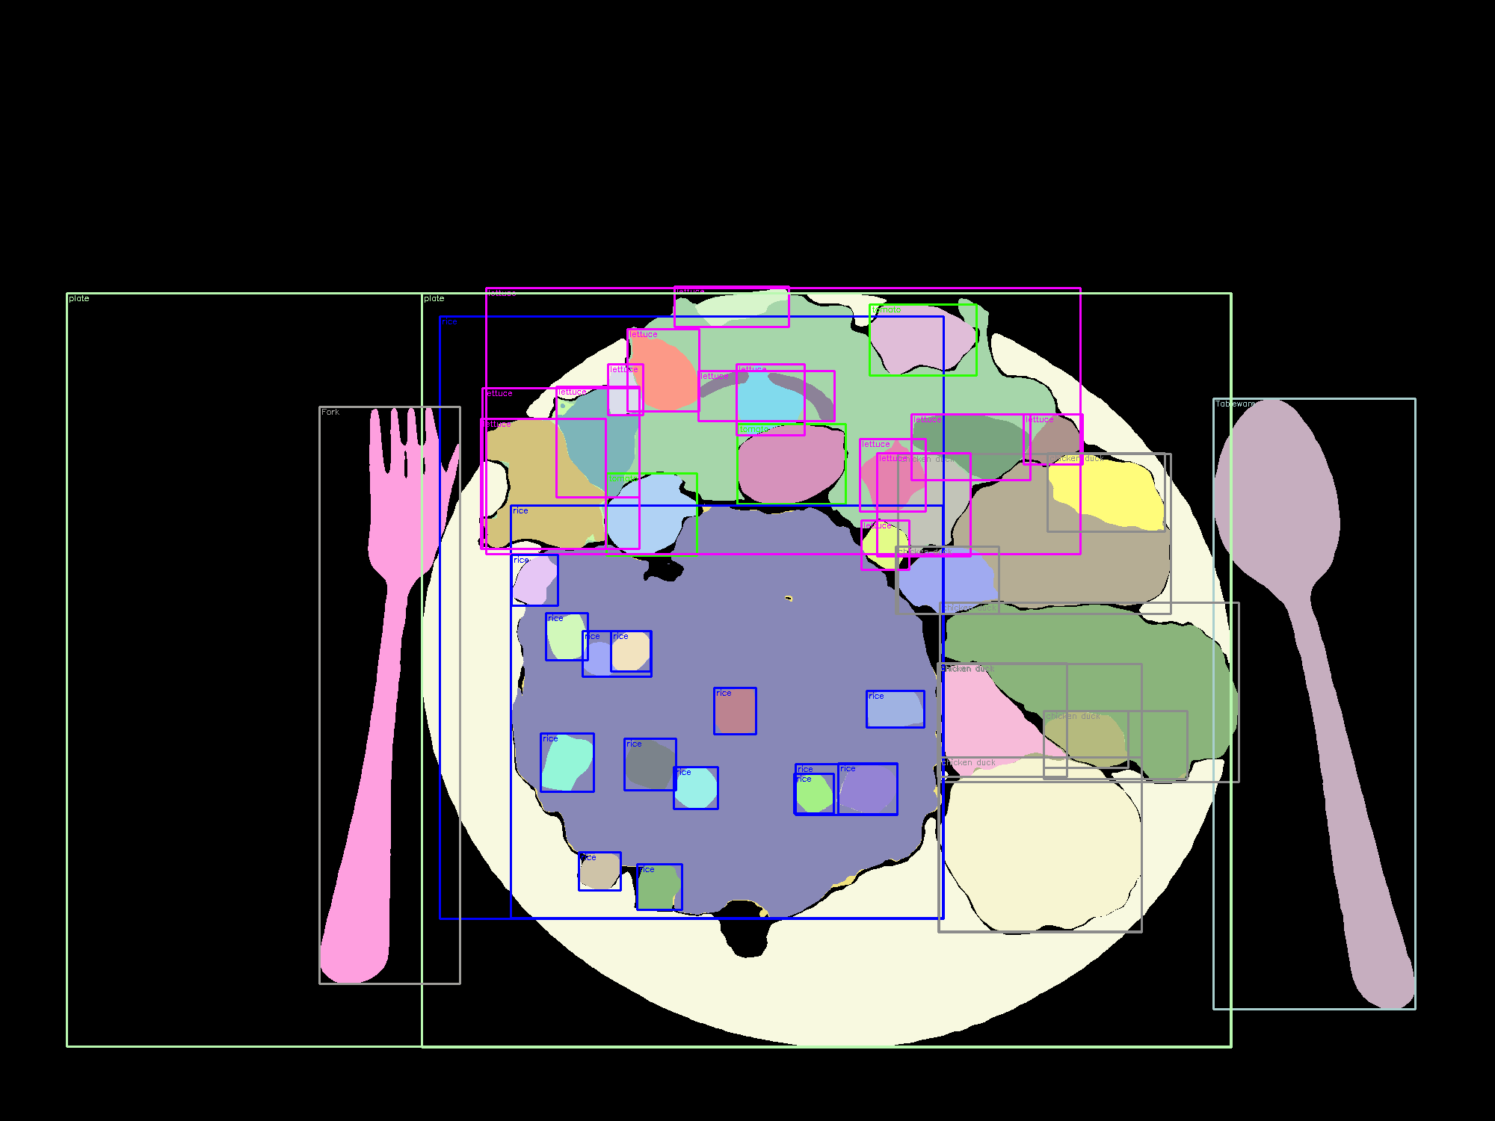
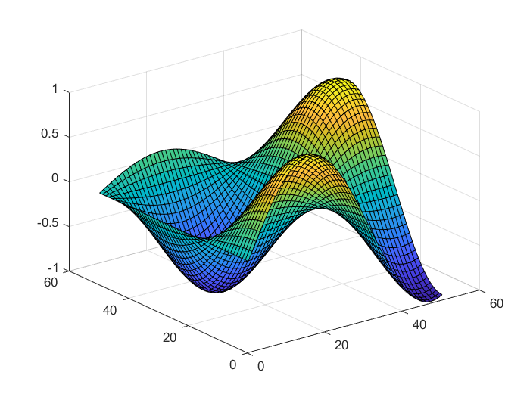
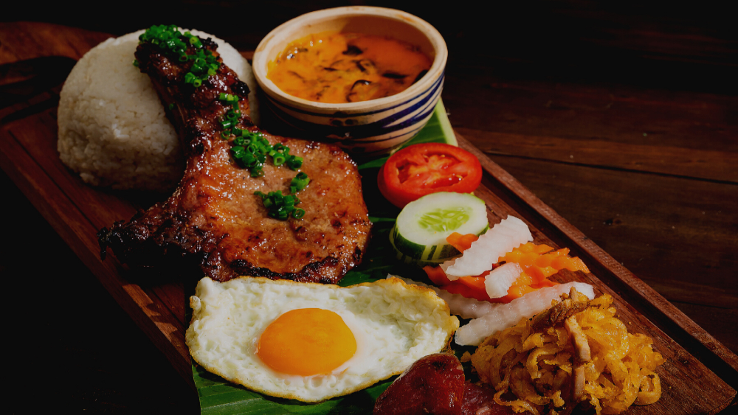
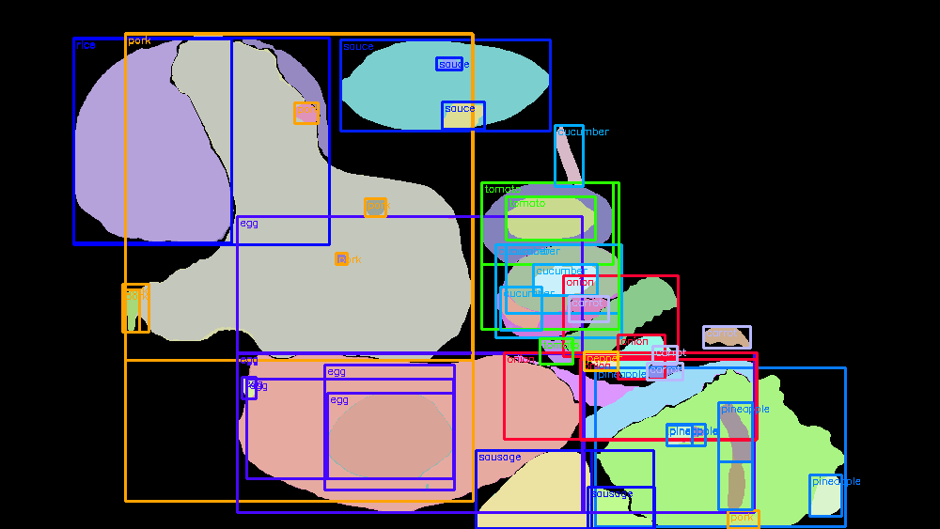
CALORIE ESTIMATION IN FOOD INGREDIENTS
Computer Vision
Data Selection and Pre-processing
Model Construction
Food Ingredients Volume
Calorie Estimation

Slide 9
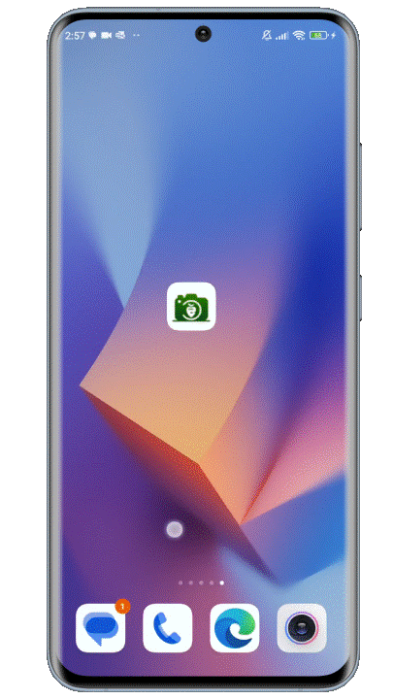
PROPOSED RESEARCH
Sub-objectives:
Implement framework for food ingredients segmentation.
Propose framework for reference card detection.
Evaluate models according to evaluation metrics.
01
02
03
9

Slide 10
RESEARCH STAGES - PROJECT CONTRIBUTION
Food Ingredients Segmentation:
SA-1B, Objects365, UECFOODPIXCOMPLETE, FoodSeg103
Reference card detection:
Manual collection dataset
Internal: Segmentation evaluation (mIOU, mAcc, aAcc)
Object detection (Precision, Recall, mAP)
External: Segmentation visualization
Data Identification
Model Evaluation
STAGE 1
STAGE 2
STAGE 3
STAGE 4
STAGE 5
Business Understanding & Objectives
Food categorical process
Future work & Report
Food Ingredients Segmentation: FoodSAM
Reference card detection: Yolov8
Real-life statistics
Inspiration of project study
10

Slide 11

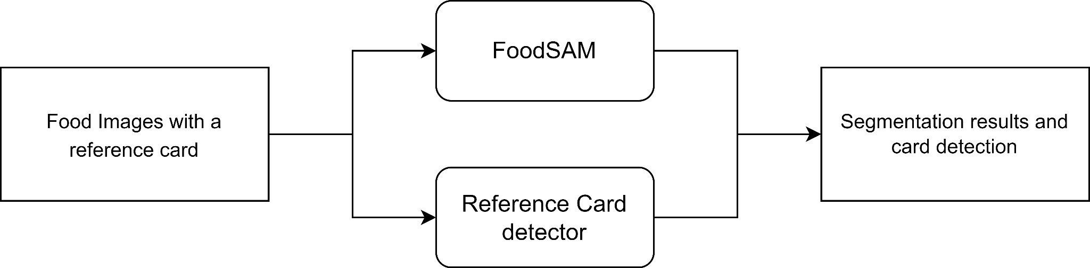
SIMPLE FRAMEWORK
Configuration:
i5-10400 CPU, 2.9GHz speed
16GB RAM, 2133 MHz speed
NVIDIA 3060 GPU 12GB memory, 3584 CUDA cores.

Slide 12
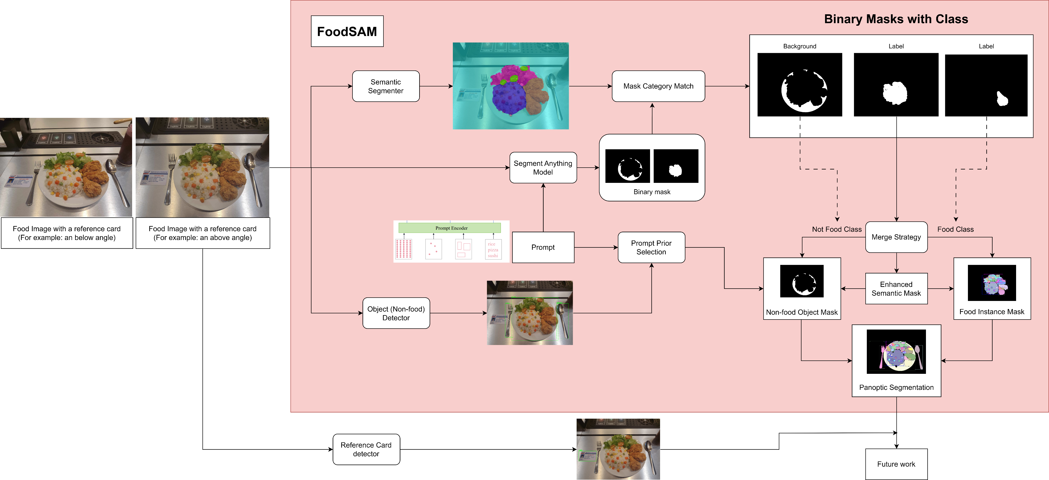
ZERO-SHOT FRAMEWORK – OUR CONTRIBUTION

Slide 13
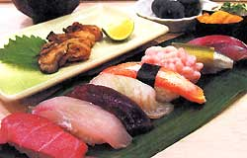
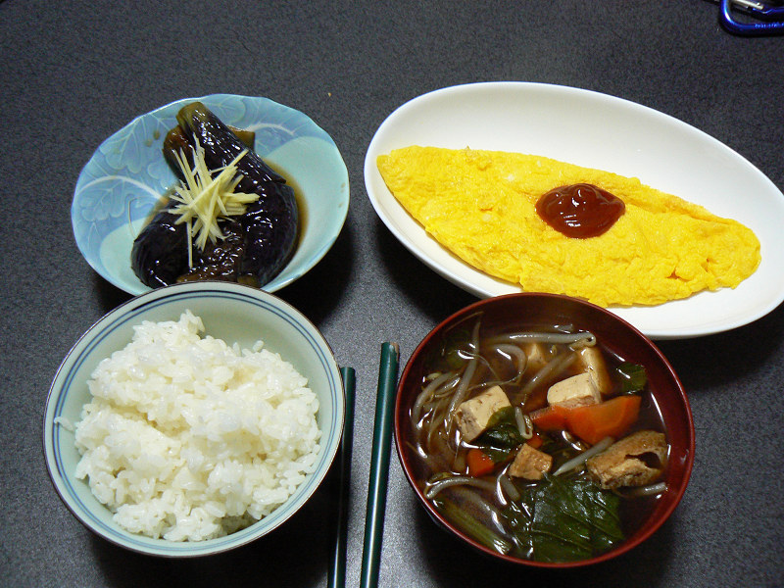
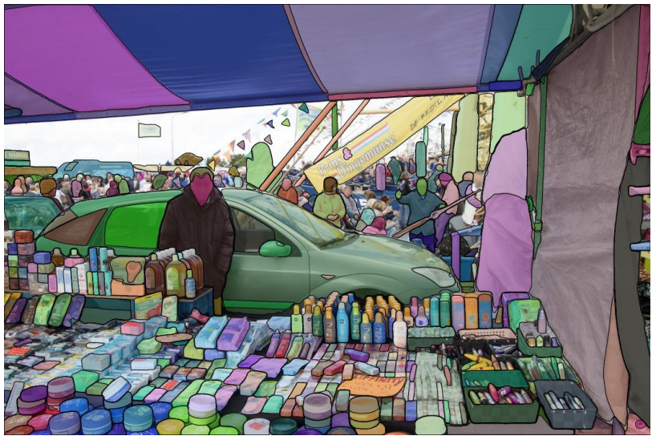
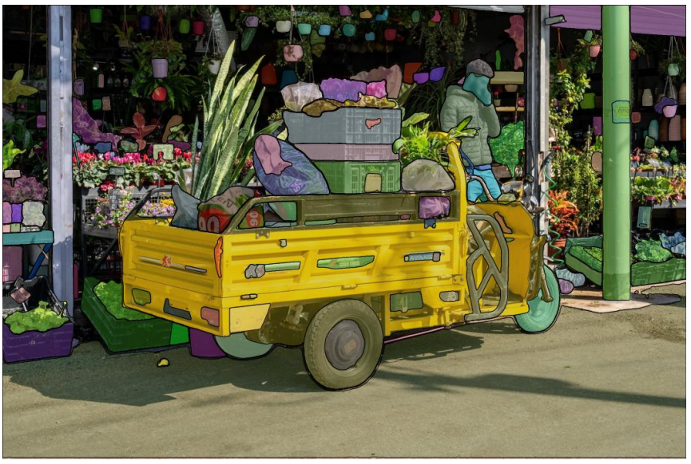
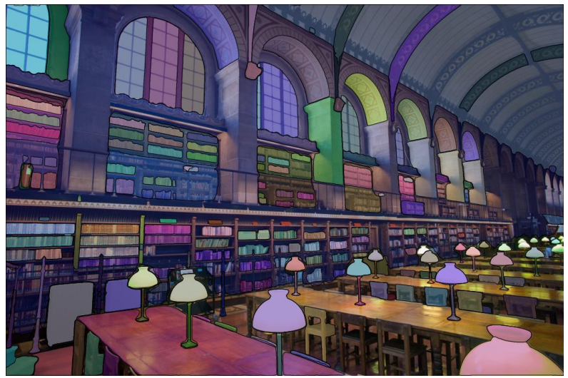
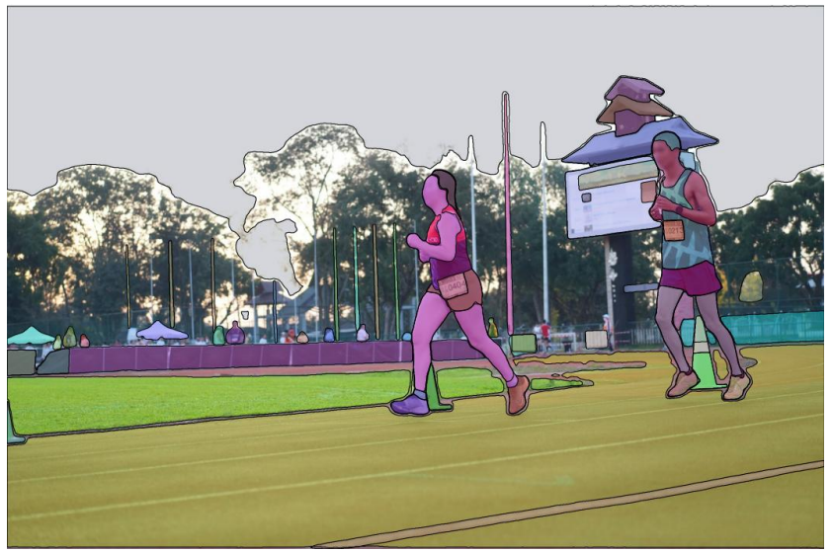
Pretrained model
UECFOODPIXCOMPLETE
9000 : 1000 (training - test images)
(9:1)
103 class labels
Detectron2
Pretrained model
SA-1B
1B masks from 11M licensed and privacy-preserving images
Training SAM

Slide 14
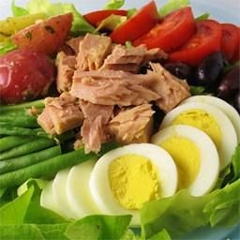
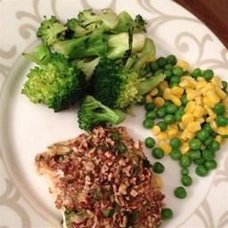
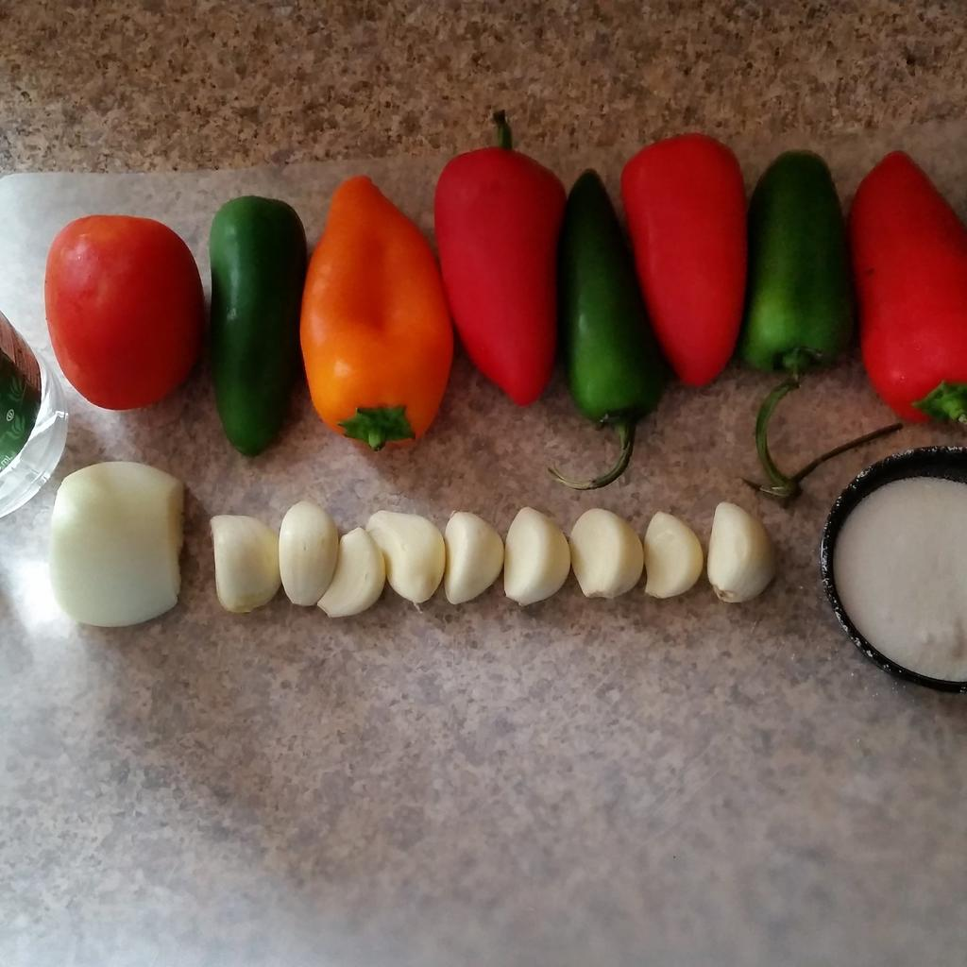
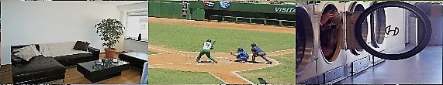
Pretrained model - FoodSeg103
7,118 images (730 dishes)
(5:2)
Training: 4983 images (29530 ingredient masks)
Testing: 2135 images (12567 ingredient masks)
104 ingredient classes
Pretrained model
740K - Objects365
600K: 38K: 100K
(Training: Validating: Testing)
PASCAL VOC & COCO with 365 object categories

Slide 15
Coarse Semantic Mask

Slide 16
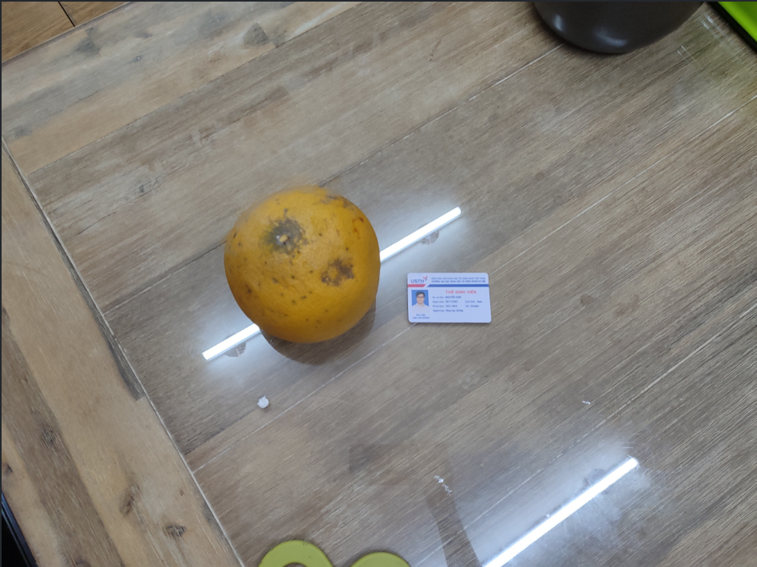
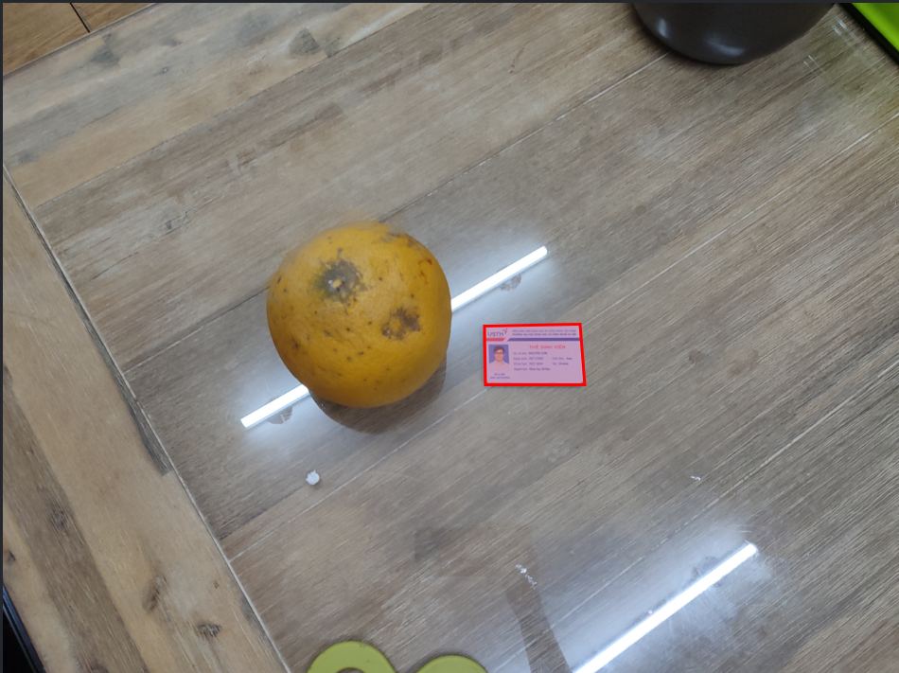
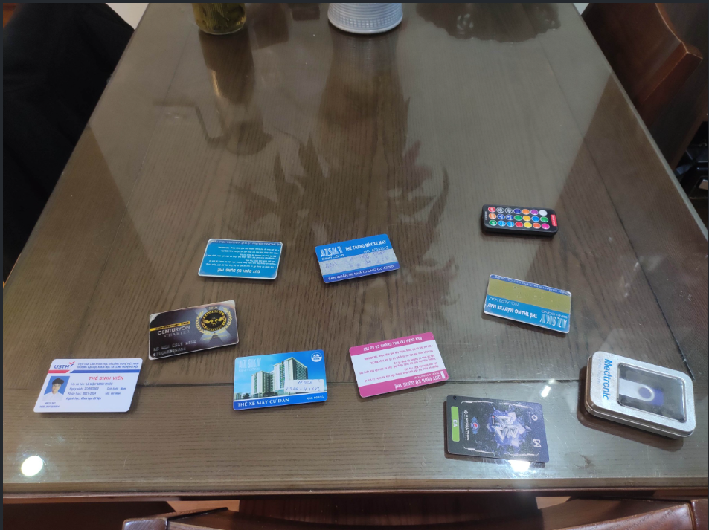
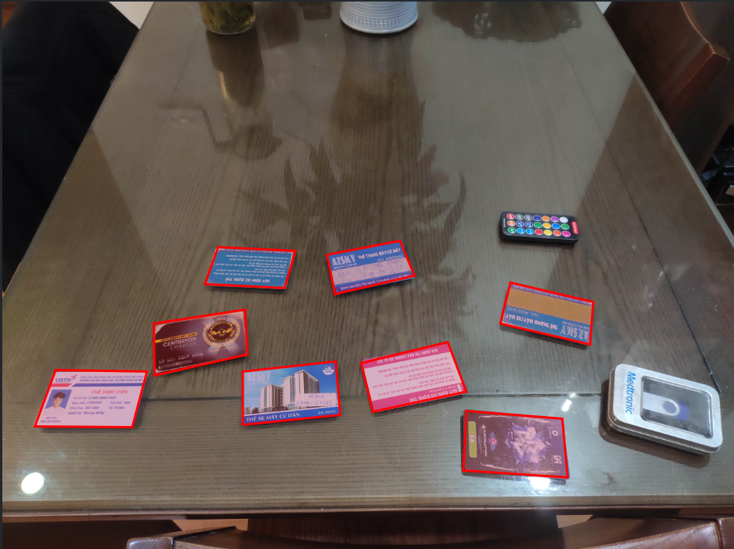
Training manual collection dataset
308 card images
Training - Testing (90:10)
Training and Testing
Yolov8

Slide 17
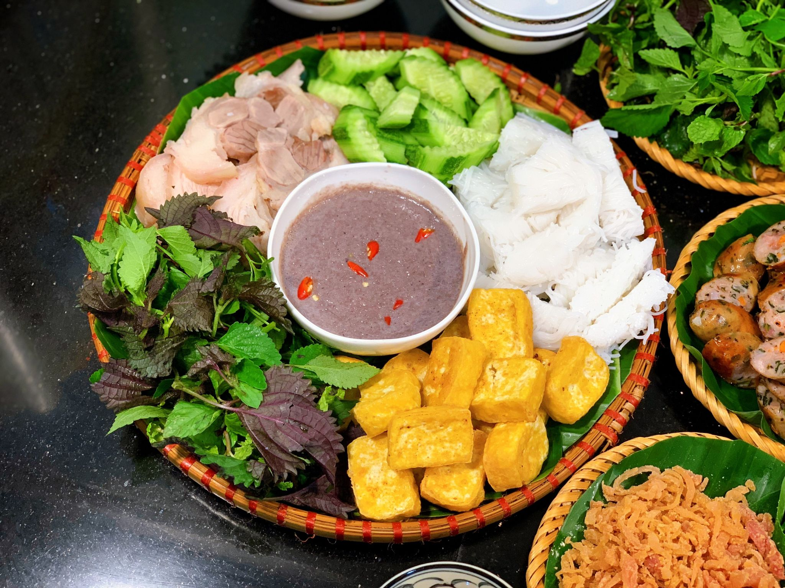
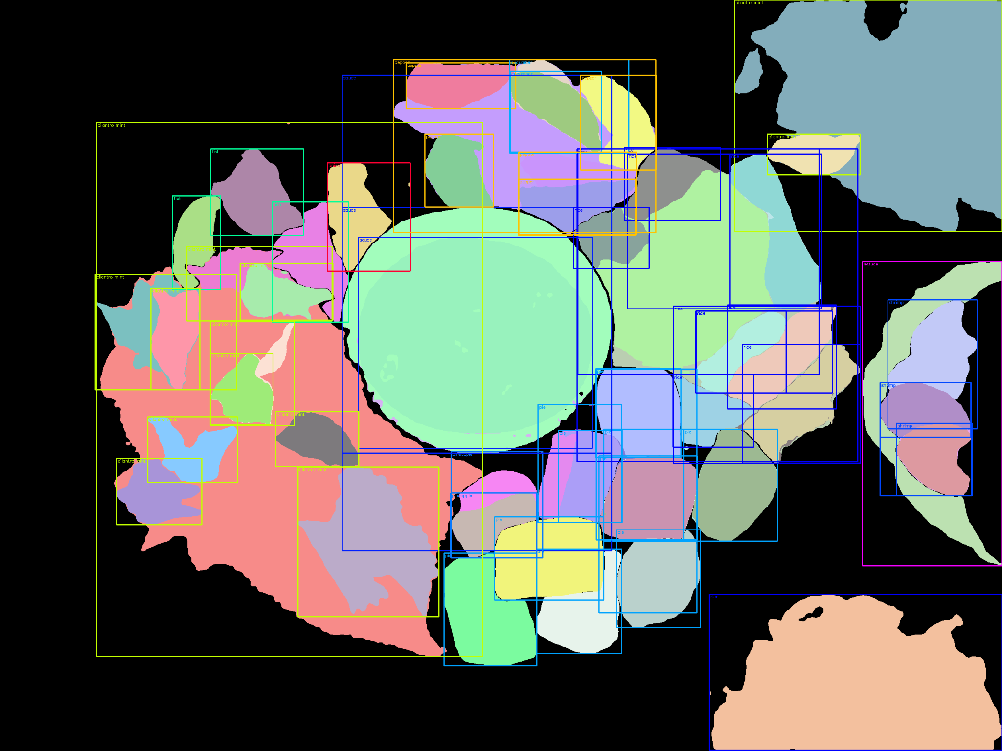
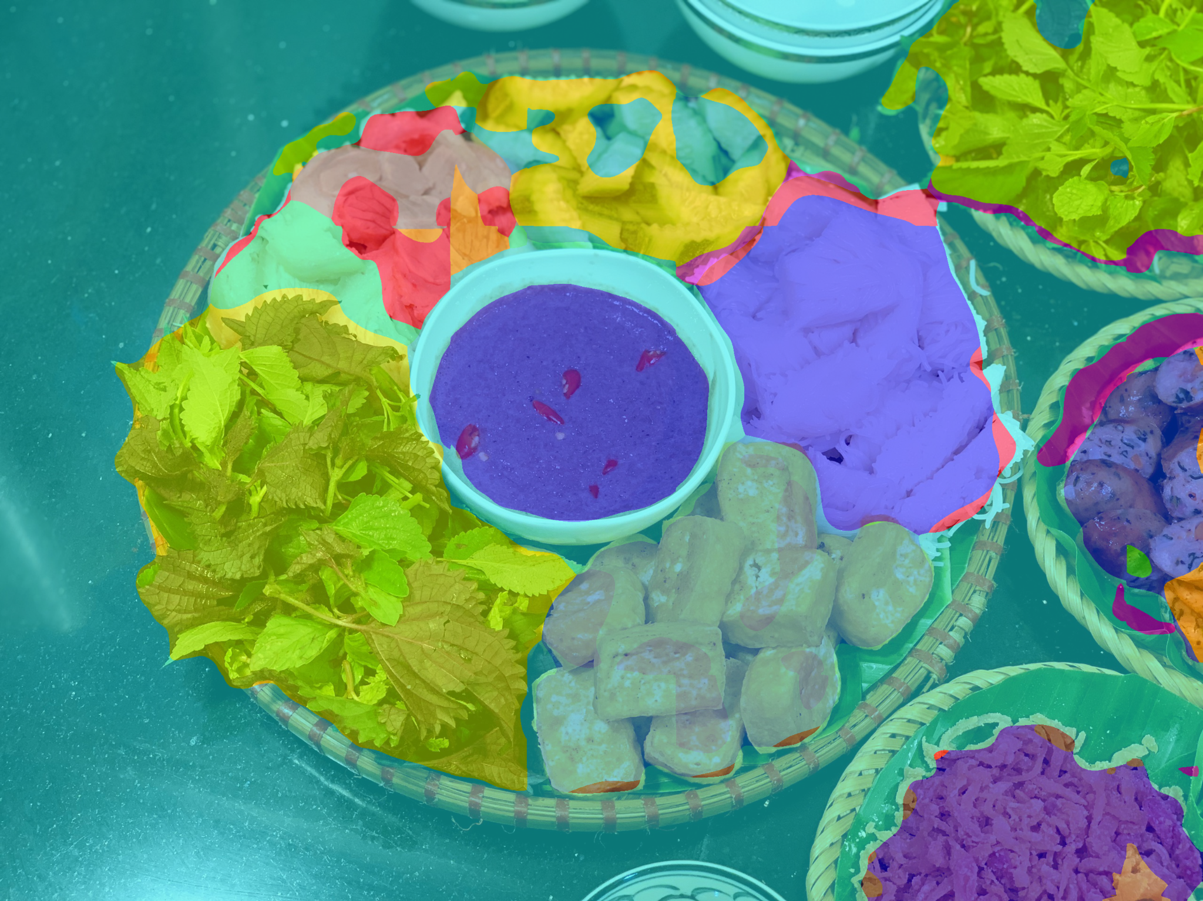
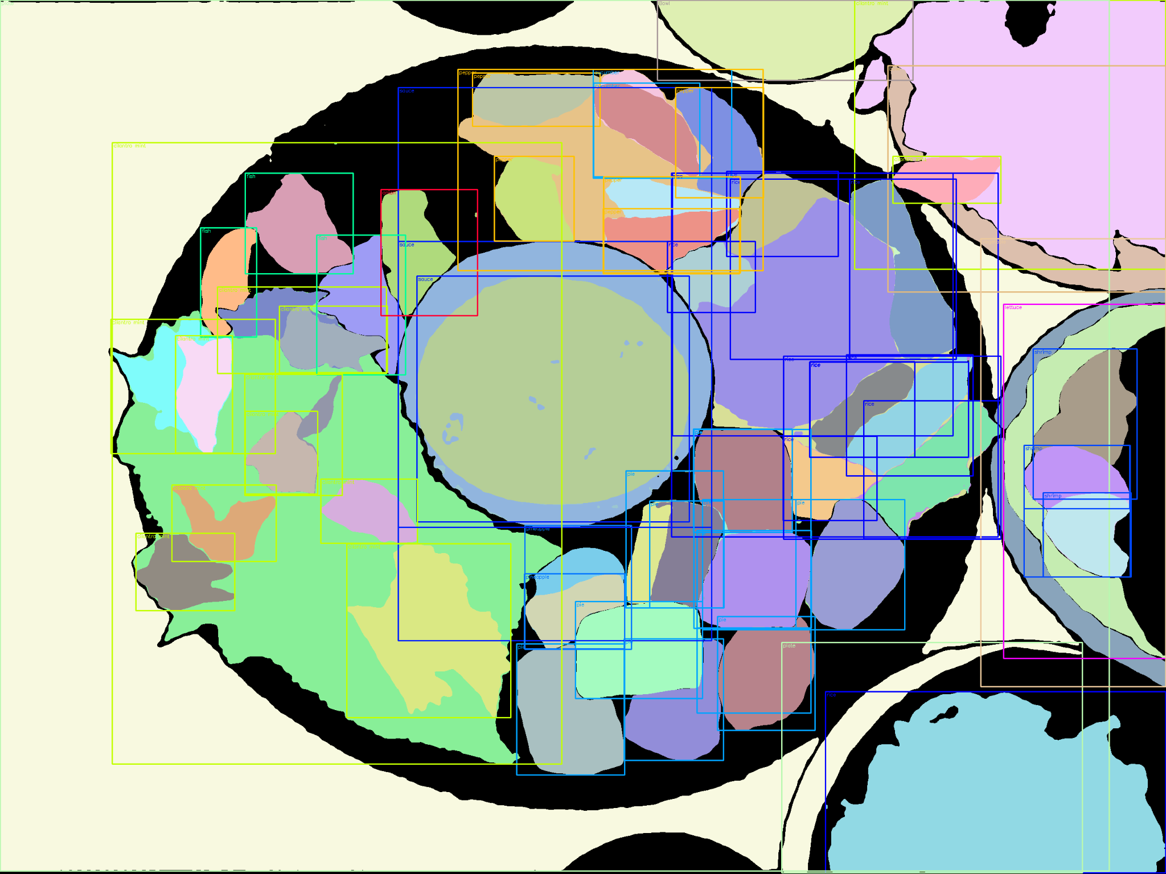
EVALUATION RESULTS
Input
Instance
Semantic
Panoptic

Slide 18
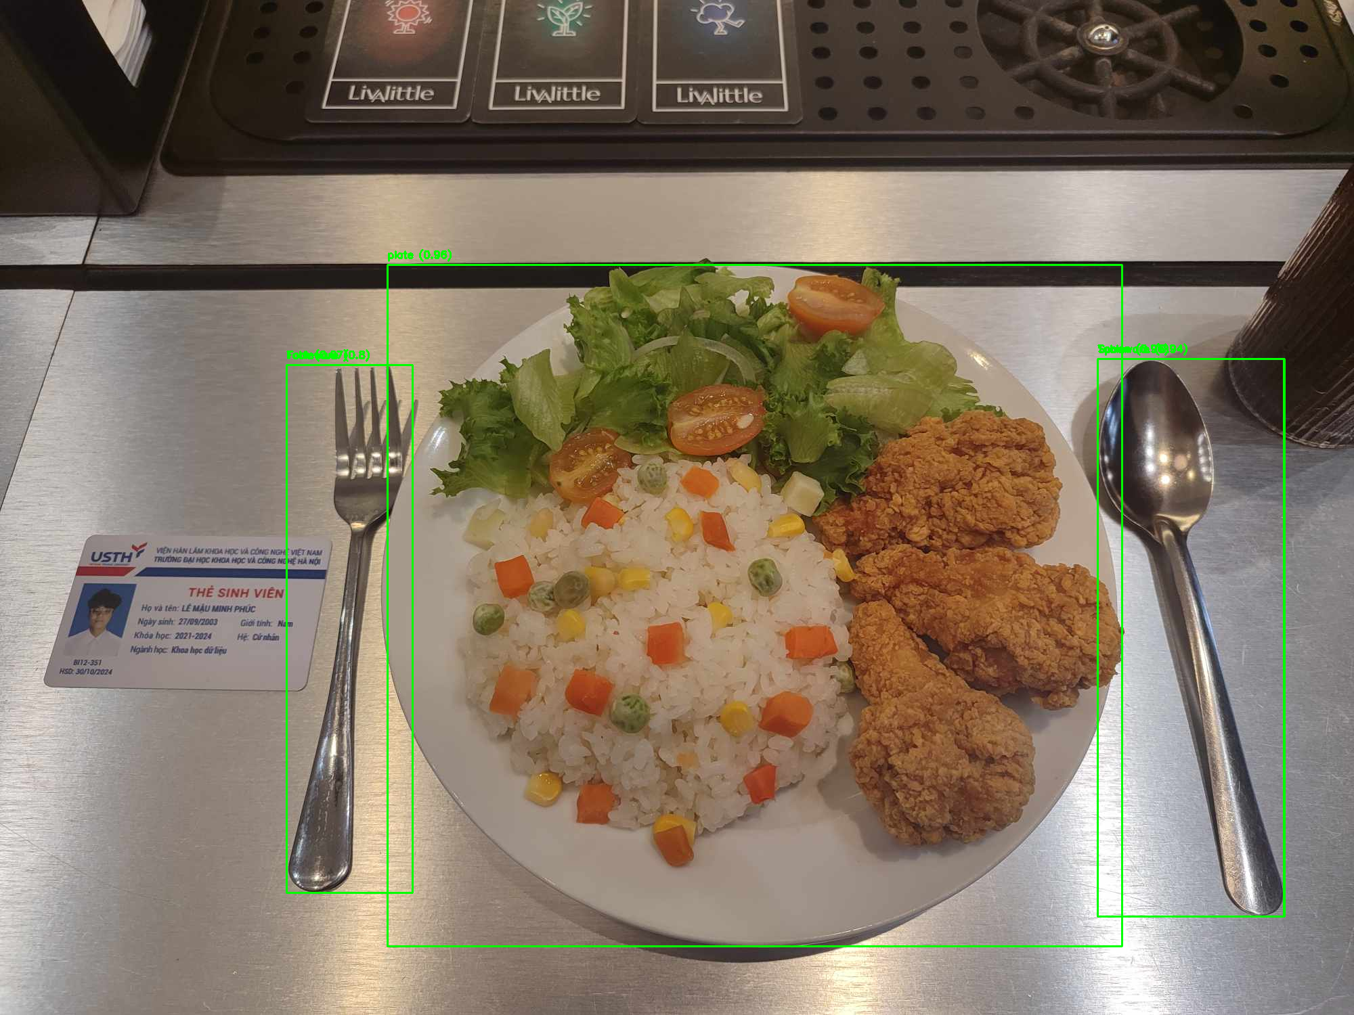
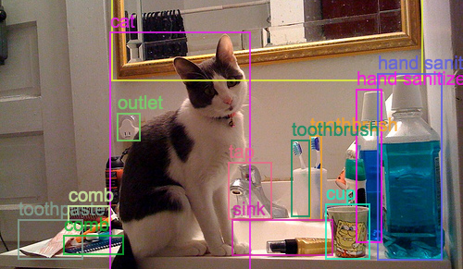
EVALUATION RESULTS
Object (Food and Non-food) detection (Unified_learned_COI_RS200_6x)
Datasets | Objects365
mAP (%) | 31.1
Raw image

Slide 19
EVALUATION RESULTS
Food Ingredients Segmentation model
(FoodSAM)
FoodSeg103 dataset
UECFOODPIXCOMPLETE dataset
Conf Threshold | mIoU (%) | mAcc (%) | aAcc (%)
0.3 | 46.41 | 57.96 | 84.48
0.5 | 46.54 | 57.87 | 84.02
0.7 | 46.19 | 58.64 | 84.39
0.9 | 45.92 | 57.56 | 84.02
Conf Threshold | mIoU (%) | mAcc (%) | aAcc (%)
0.3 | 65.64 | 77.76 | 87.56
0.5 | 66.18 | 78.11 | 88.01
0.7 | 65.88 | 78.48 | 88.20
0.9 | 66.56 | 77.98 | 88.04
Run-time for entire model:
5 seconds per image

Slide 20
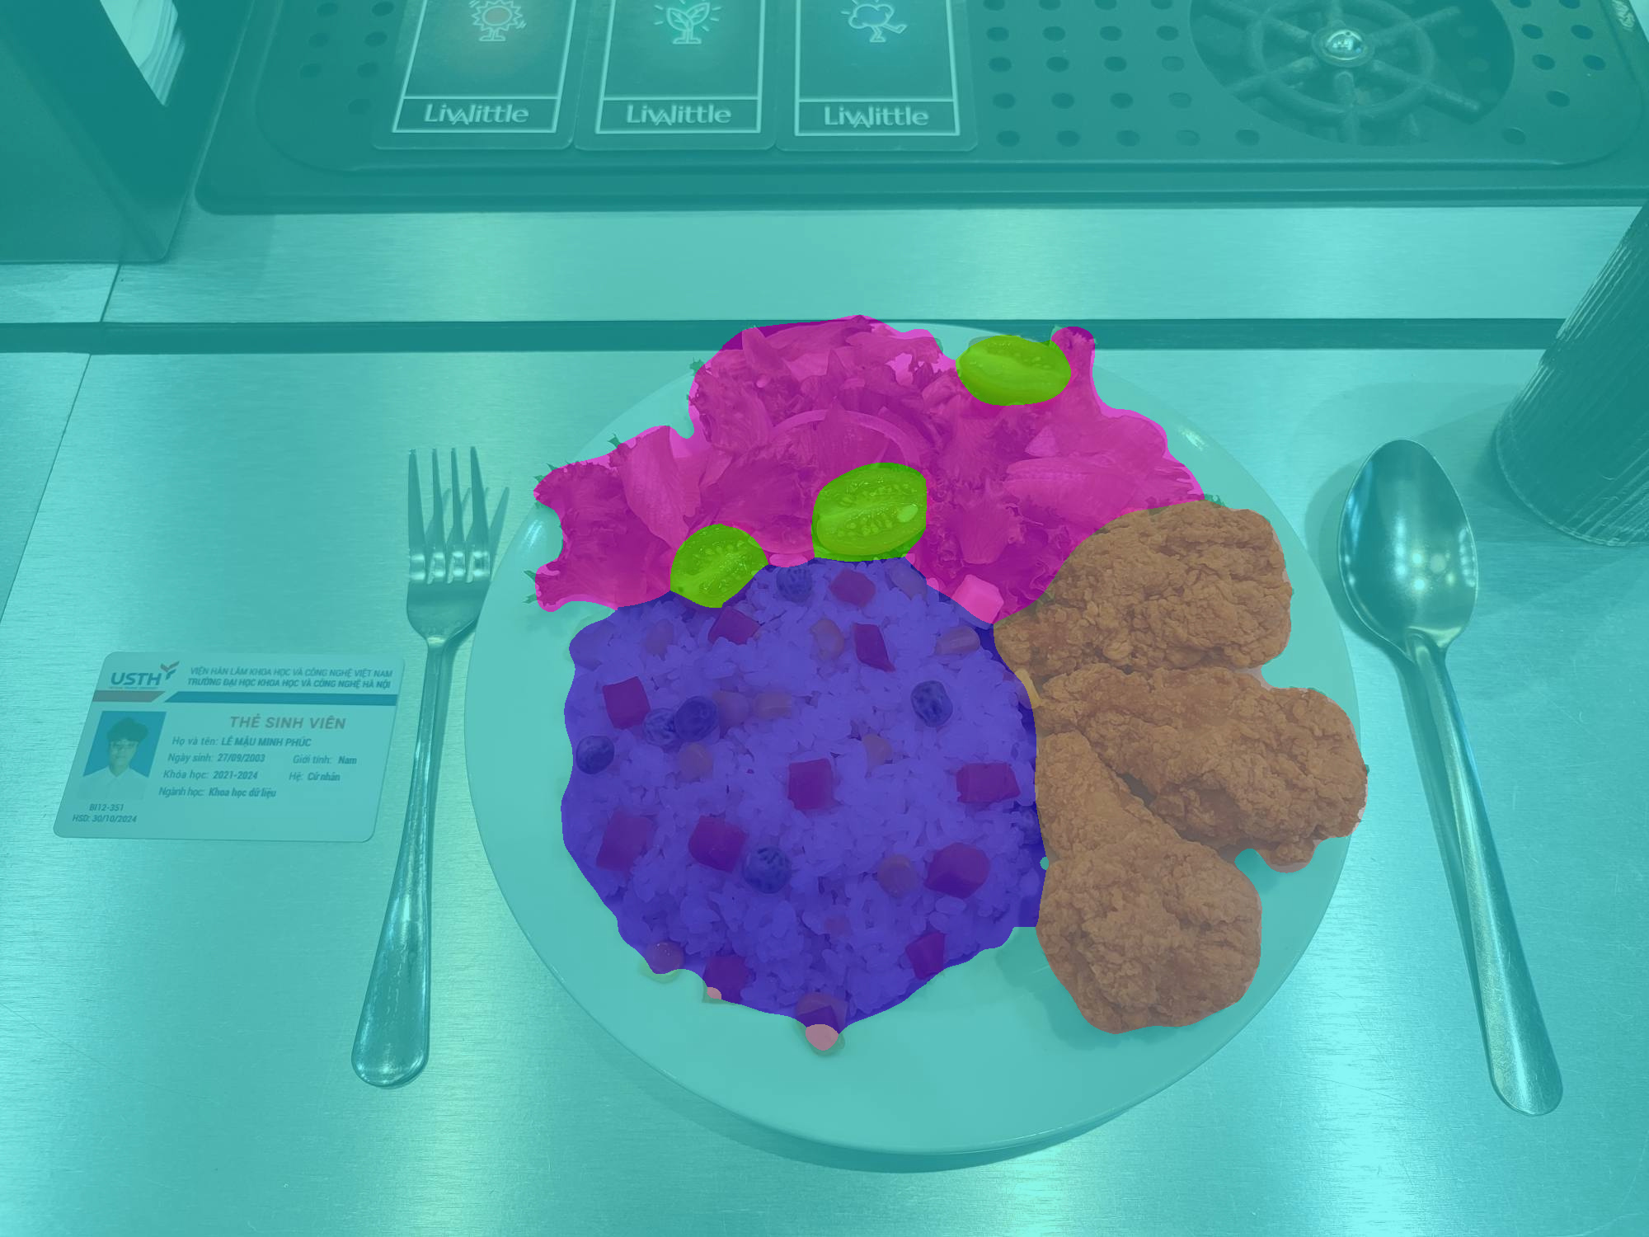
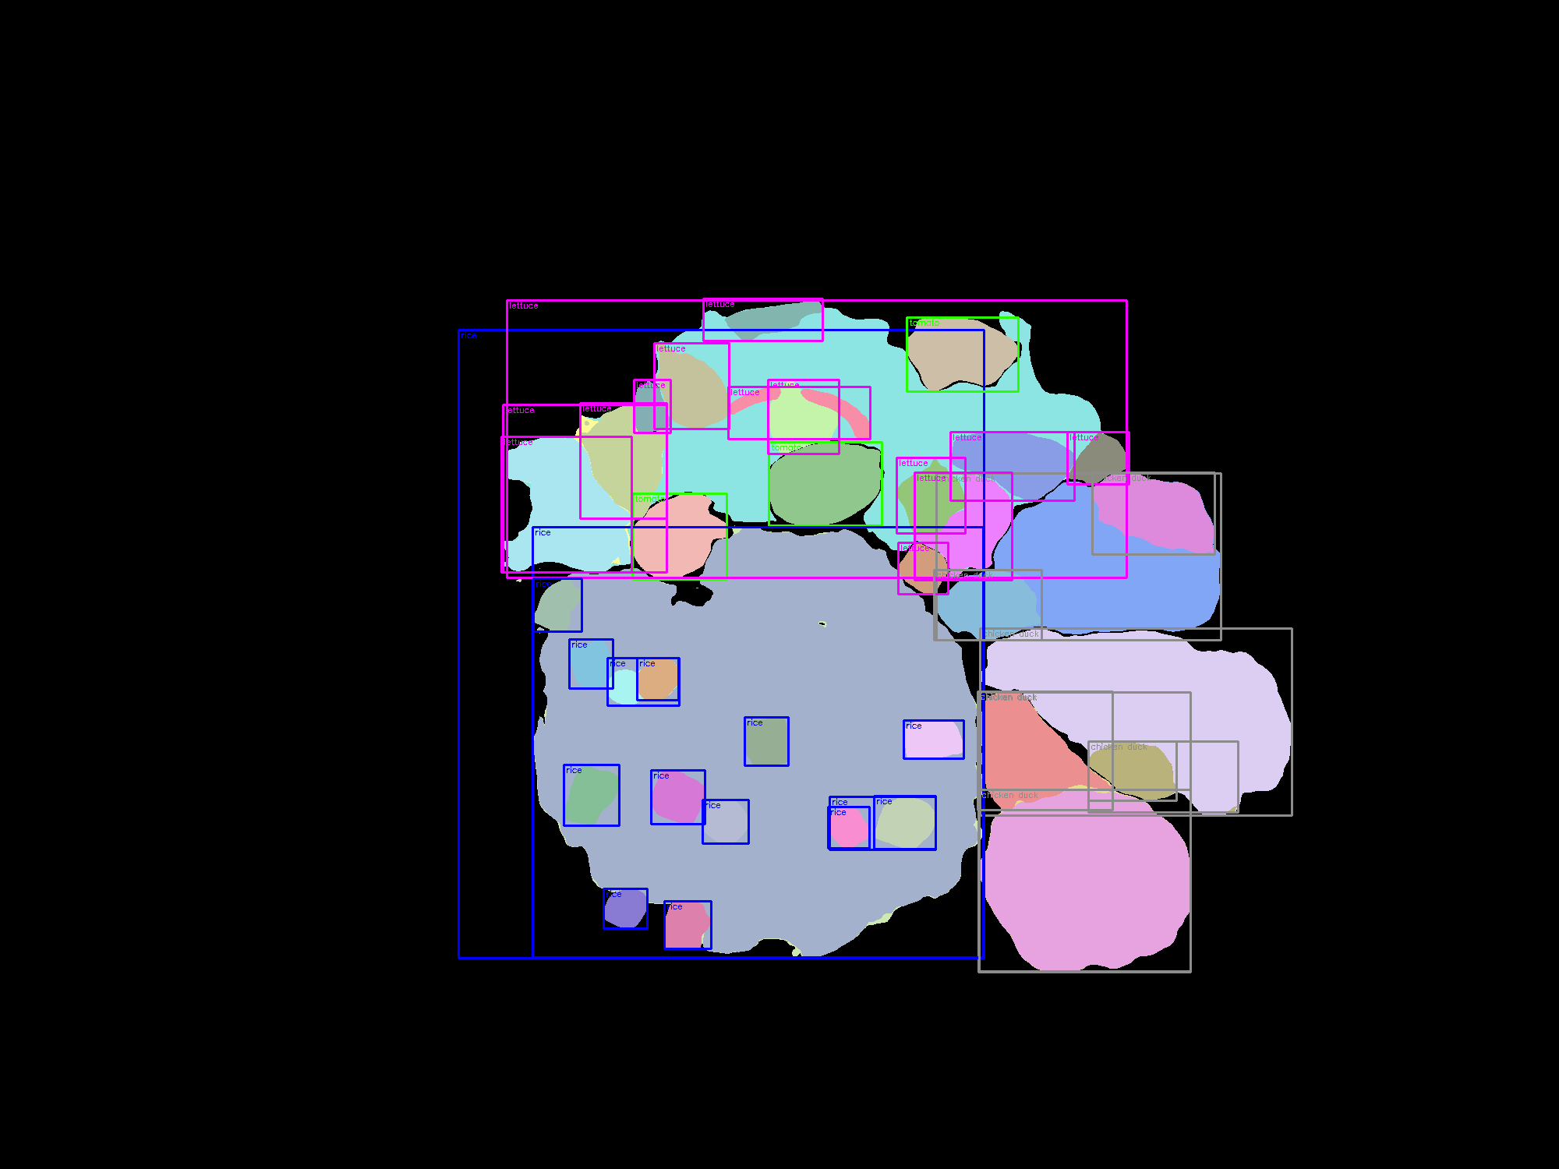
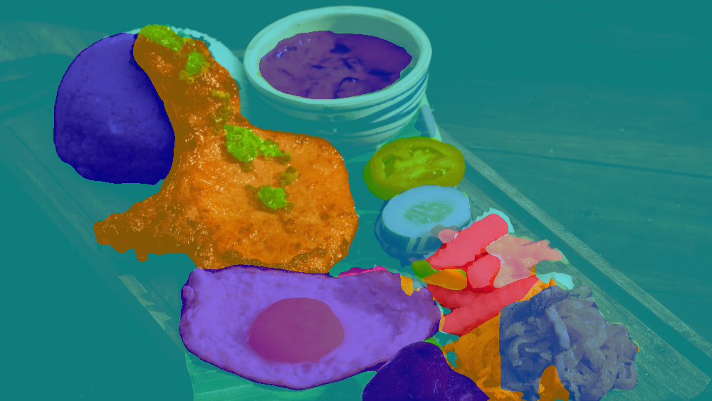
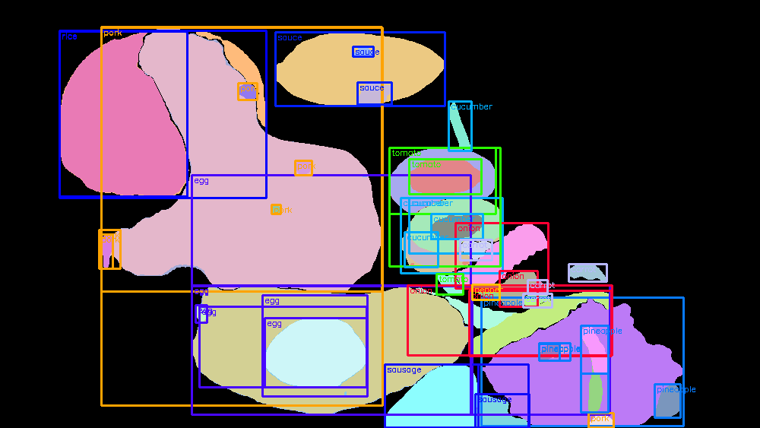
EVALUATION RESULTS
Input
Semantic
Instance
Panoptic

Slide 21
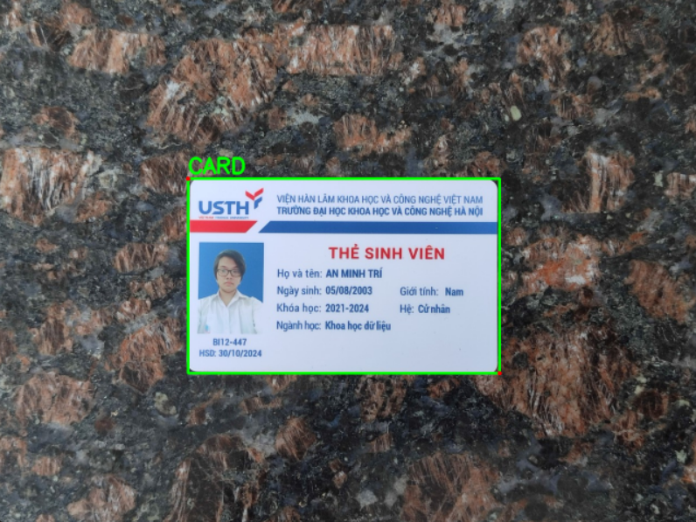
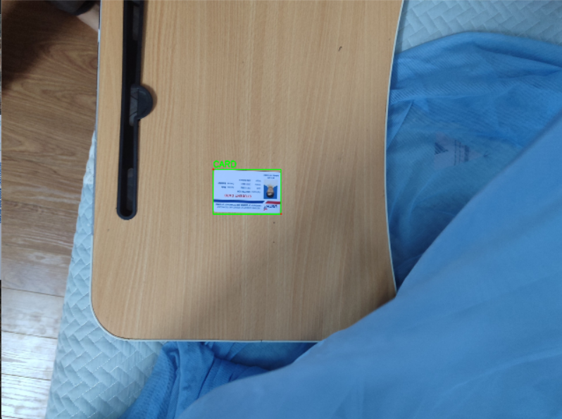
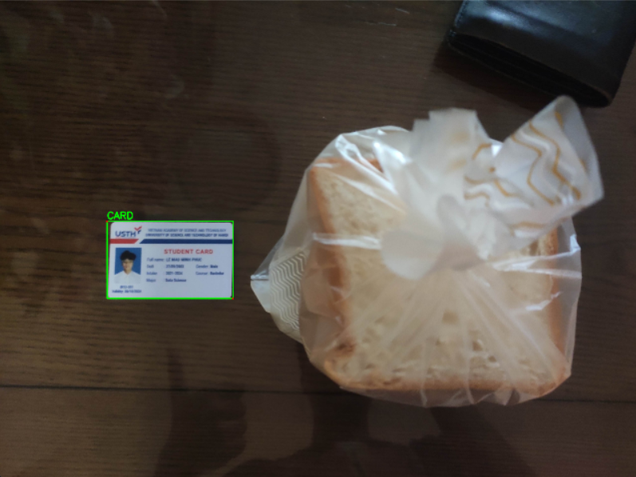
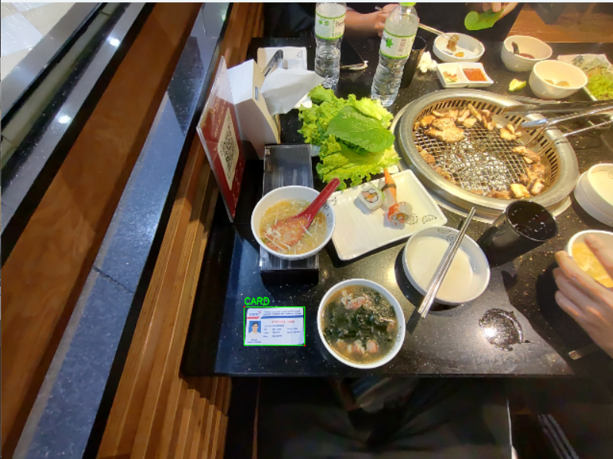
EVALUATION RESULTS
Yolov8
 | Results
Precision | 0.8775
Recall | 0.96667
mAP50 | 0.90979
mAP50-95 | 0.87548
Cards in different positions

Slide 22
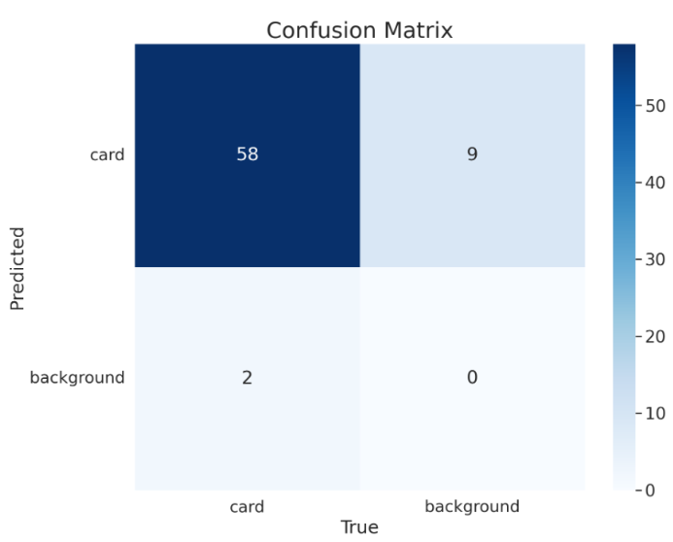
EVALUATION RESULTS
Confusion metrics
Yolov8
 | Results
Precision | 0.8775
Recall | 0.96667
mAP50 | 0.90979
mAP50-95 | 0.87548

Slide 23
CONCLUSION
To indicate a proposal development process
To implement project zero-shot framework
To evaluate the models

Slide 24

LIMITATIONS
Input dataset for better testing.
Model evaluation metrics.
Computer configurations.
Results comparison with public papers.
24

Slide 25
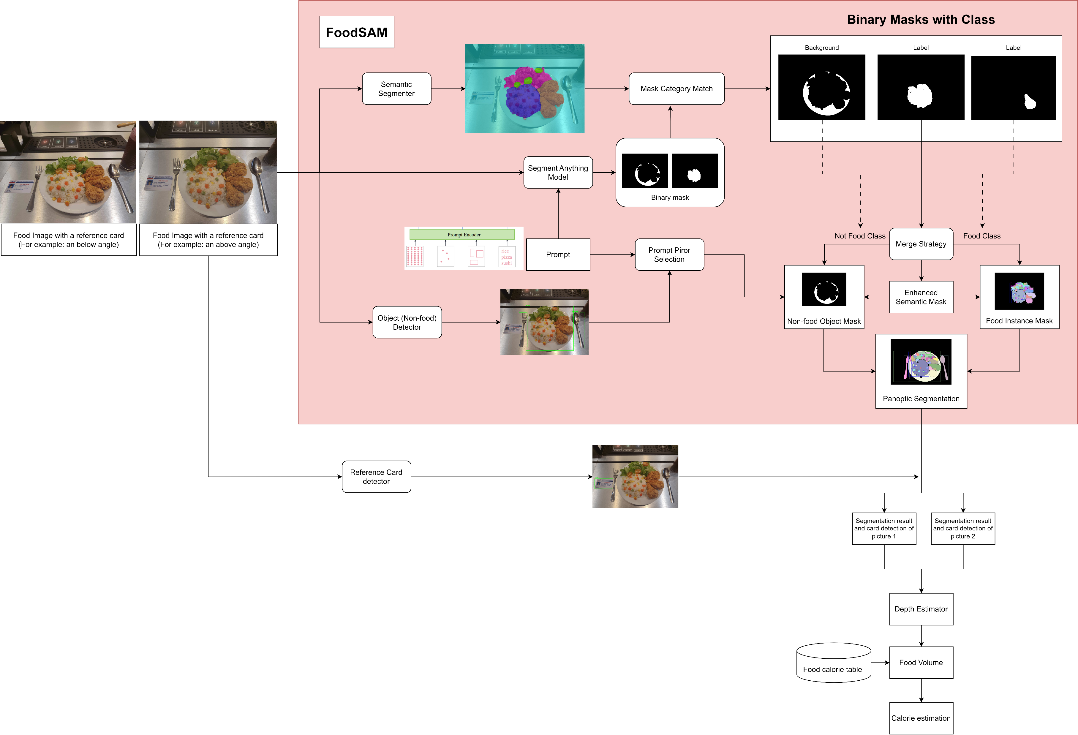
FUTURE WORK

Slide 26

FUTURE WORK
Depth estimator (Integral to predict food volume)
Retrain in different conditions
Computer configuration
Vietnamese food database
Freshness of food
Anti-spoofing
Comparison with traditional/ latest techniques.

Slide 27
FUTURE WORK WITH THE APP
To implement front-end and back-end
To propose a calorie estimation, meal tracking, fitness and health-related application
To implement food and exercises recommendation
To collaborate with fitness experts and nutritionists
27

Slide 28
28

Slide 29


COMPETITORS / MARKET REFERENCES

Slide 30

COMPETITORS / MARKET REFERENCES

Slide 31
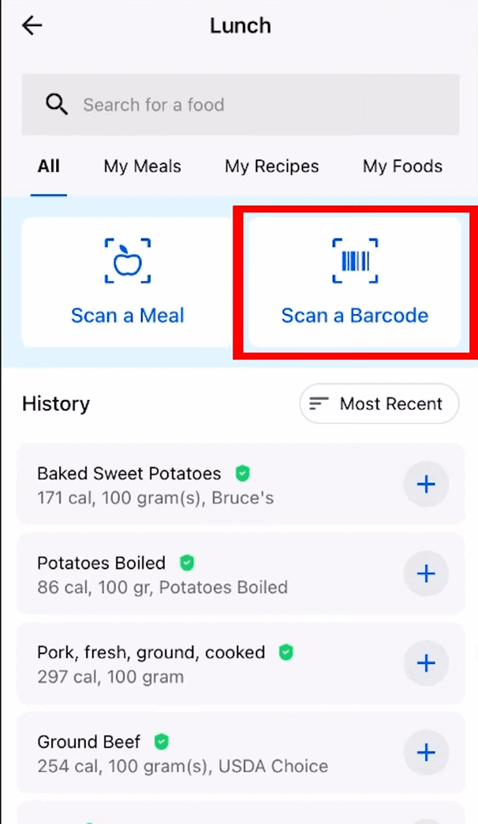




COMPETITORS / MARKET REFERENCES

Slide 32



COMPETITORS / MARKET REFERENCES

Slide 33


Depth Estimation
Source: Satyarth Praveen
Source: Wikipedia

Slide 34



SOCIAL IMPACT
Combatting Obesity and Related Health Issues
Educational Value

Slide 35

TARGET CUSTOMERS
All people with a variety of ages
Children with parental assistance

Slide 36



COMMUNICATION AND MARKETING PLANNING
Customer Feedback
Influencer Partnerships
Social Media Campaigns

Slide 37

COMMUNICATION AND MARKETING PLANNING
Health, wellness, and Vietnamese cuisine influencers.
Host live sessions, workshops and webinars.
Source: Impact.com
Influencer Partnerships

Slide 38

COMMUNICATION AND MARKETING PLANNING
Facebook, Instagram, and TikTok.
A nutritional education on CaloCam.
Source: Mango Animate
Social Media Campaigns

Slide 39

COMMUNICATION AND MARKETING PLANNING
Enhance CaloCam’s features and user experience.
Source: Qualaroo
Customer Feedback

